Slide 1
Microclimate Overview and Strategy End to end development platform for developing, building, testing and deploying code
Notes:
Welcome everyone to a presentation on Microclimate. It is IBM’s new developer experience platform that helps build end to end, cloud native services using containers for a Kubernetes platform. The initial release of Microclimate was at the end of March of this year, and we will continue to provide upgrades to it on a continuous delivery stream of monthly or even sooner if there is some great new functionality we want to get out quickly. It is a free download from the Microclimate website or can be accessed via the IBM Cloud private catalog.
In the presentation today, we’ll do a brief introduction and then run through a demo, as seeing is believing and then we’ll come back and talk about the capabilities that we’ve added to provide developers the ability to build awesome cloud native applications.
Just to reiterate – this tools experience is meant to be an end to end experience with Developers in charge!

Slide 2
Please note
IBM’s statements regarding its plans, directions, and intent are subject to change or withdrawal without notice and at IBM’s sole discretion.
Information regarding potential future products is intended to outline our general product direction and it should not be relied on in making a purchasing decision.
The information mentioned regarding potential future products is not a commitment, promise, or legal obligation to deliver any material, code or functionality. Information about potential future products may not be incorporated into any contract.
The development, release, and timing of any future features or functionality described for our products remains at our sole discretion.
Performance is based on measurements and projections using standard IBM benchmarks in a controlled environment. The actual throughput or performance that any user will experience will vary depending upon many factors, including considerations such as the amount of multiprogramming in the user’s job stream, the I/O configuration, the storage configuration, and the workload processed. Therefore, no assurance can be given that an individual user will achieve results similar to those stated here.

Slide 3
The cloud has evolved as the technology for transformation
Cloud Native Tools
Value
Mix & Match deploy
3.0 Cloud Native tools
Desktop Tools
2.0
Mix & Match Deploy
1.0
Desktop Tools
Tools and processes that are tightly coupled to the environment
Tools that is tightly integrated to your runtime
Existing tools and start using DevOps tools
Tactical
Strategic
IBM Cloud / © 2018 IBM Corporation
Notes:
With the evolution of cloud, you see applications being created for the cloud (cloud native), or enhanced to take advantage of cloud services in on-premises applications (hybrid cloud). Applications are lifted from on-premises, and running on the cloud (IAAS). The tools have undergone a similar evolution. It started off with desktop tools that were very targeted, and provided support for certain runtimes. Then, it progressed to mixing and matching some DevOps capability like continuous integration. Now, it has evolved to the 3.0 boot of cloud native tools. These tools are tightly integrated with the platforms, and take advantage of the capabilities in the cloud itself to leverage new value for applications or services.

Slide 4
Multi-cloud is the key to organizational agility
8 out of 10 committing to Multi-Cloud
71% use 3 or more clouds
+
Public
Private
Getting new value from
third parties
Extracting value from
your entire business
Need tools that take advantage of the cloud platform
IBM Cloud / © 2018 IBM Corporation
Notes:
Every enterprise is looking at their cloud options. Enterprises want to take advantage of either pushing the operations capability off to the cloud vendor in the case of public clouds or consolidating the operations capability onto an on premise cloud. A multi cloud capability allows enterprises to take advantage of services that are provided by third party vendors in public while allowing enterprises to take advantage of their existing portfolio. The tools that enterprises use need to be able to work with both public and private cloud and support enterprises in their multi cloud journey.

Slide 5
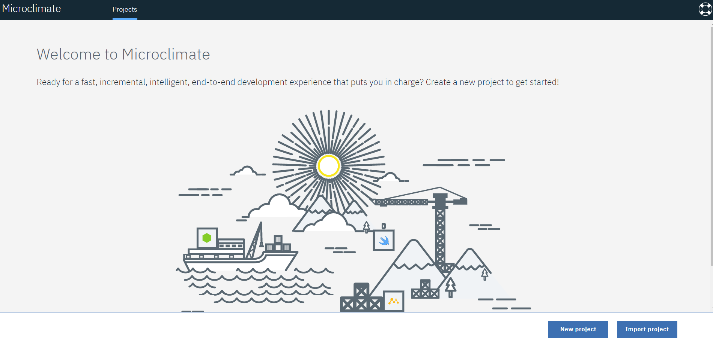
https://microclimate-dev2ops.github.io/
Notes:
I want to introduce you to Microclimate. It is IBM’s new developer experience platform that helps build end to end, cloud native services using containers for a Kubernetes platform. It is a free tool that can be downloaded from the website noted in this chart or it is in the IBM Cloud private catalog and can be installed directly onto IBM Cloud private and run within a browser based environment (no download needed).
We’ll now switch over to a demo to show you Microclimate capability and then we’ll talk more about some of the capabilities that you’ve seen.

Slide 6
DEMO

Slide 7





Microclimate - an end to end development platform to develop, build, test and deploy code
Get started quickly with choice of programming languages
Fast development cycle to develop, build, test to maximize team agility
Integrated DevOps experience that supports deployment to IBM Cloud Private
Choice with consistency
Hybrid integration
DevOps productivity
Powerful, accessible data and analytics
Cognitive solutions
Seamless Experience
Regardless of where your development experience started, you get a single, seamless experience.
Notes:
Microclimate is meant to be an end to end developer experience. From getting started quickly with your choice of programming languages and frameworks, to making changes quickly either through the browser based editor Theia, an open source editor, or by your own editor of choice that works with microclimate, building and testing locally, in a lightning fast manner, all in containers to get the service ready to go and then by creating a DevOps pipeline which will do the clean build of your service, run any tests as part of the continuous integration step and deployment out to the various staging environments that have been setup. Throughout the whole development experience, Microclimate can provide real time insights through its app metrics capability and real time feedback through any Language server protocols (LSPs) that have been integrated into the editor. Since all development is done in containers from the beginning, the experience is seamless from development to production.

Slide 8
Key use cases
1
2
3
Simplify the creation and deployment of microservices
Modernize and optimize existing applications
Embrace new programming practices such as agile and DevOps
Microclimate provides a full cycle developer experience
IBM Cloud / © 2018 IBM Corporation
Notes:
Microclimate can be used for all the key use cases that your enterprise is looking at for developing, enhancing or porting services or applications to the cloud. Microclimate provides a great getting started experience for multiple languages and frameworks. It also has the capability to import services or applications via git or disk or archive which allow you to continue to enhance or modernize the services with new capabilities. Or you can import the service and just use Microclimates DevOps pipeline to push your service or application into the various staging environments into production. Embracing new agile and DevOps processes.

Slide 9




Microclimate supports your entry point for transformation:
Adopt New Technologies
Adopt New Tools
Adopt New Processes
Adopt Cloud
Architectural patterns (Microservices)
Frameworks (Java MicroProfile, Spring, ..)
Node.js, Swift
Git, Github, Gitlab
Jenkins
Docker
Continuous Integration
Continuous Build
Continuous Deploy
Agile Dev Models
Docker, Kubernetes
Culture
Notes:
All enterprises are undergoing a transformation journey. We recognize there are multiple entry points for those journeys. Whether it is adopting new technologies such as new architectural patterns such as microservices, new frameworks such as MicroProfile or Spring or new languages like node or swift. Enterprise are adopting new tools for the software lifecycle process such as docker, git or Jenkins and with that sometimes new processes such as continuous integration, continuous deploy or agile dev models and finally, we know that all enterprises are evaluating clouds and seeing how they can take advantage of different cloud platforms to bring value to their business.

Slide 10


Built with open standards, to support developer choice
Text or image
Text or image
Text or image
Text or image
Support for popular Java stacks including Java EE/MicroProfile and Spring
Multiple language support for Node and Swift
Speed and agility with safety using integrated DevOps
Manage containers at scale
Java
Polyglot
Pipeline
Containers
IBM Cloud / © 2018 IBM Corporation
Notes:
Microclimate supports open standards for building services.

Slide 11




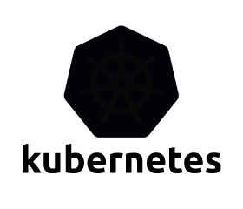
Solution Overview
Quick start samples and import capability
Get started quickly and stay on pace
Rapid Iteration
Quickly enhance, build and test
Strategic Value:
Integration with IBM Cloud Private gives you an integrated developer platform for developing, building, testing, deploying code
Intelligent Feedback & Diagnostics
Fast development with real time feedback
Integrated DevOps Pipeline
Get into production fast with a preconfigured DevOps pipeline
Free download to run locally or on IBM Cloud Private
11
11
IBM Cloud / © 2018 IBM Corporation
Notes:
The key tenets of Microclimates end to end development process is to get started quickly – Microclimate provides quick start samples and import capability for existing services, rapid inner loop iteration, intelligent feedback and diagnostic information and an integrated DevOps pipeline to provide the capability for developers to go end to end quickly.
Integration with IBM Cloud private provides the truly end to end experience for this.

Slide 12






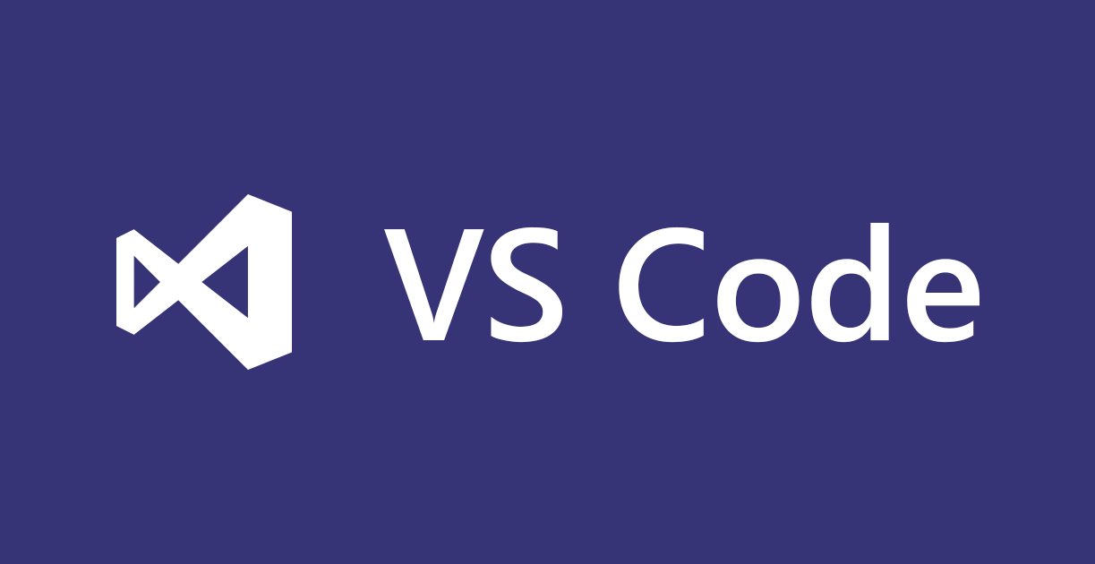




Microclimate scope
Dev Portal
Create Services
Inner Loop Services
Dev Ops Pipeline
Developer Access
Manage Applications
DevOps Tool Chain
Launch & Manage Microclimate Dev Tools
App Generation
Enable and Upgrade Existing
Zero Migration Services
Template to App conversion
Language Server Protocol Support (Polyglot, BYOE)
Incremental Build for fast dev cycles
Integrated Performance Monitoring
Integrated Environment Setup and Configuration
Automated Jenkins Build and Deploy Pipeline
Git integration
ICP Kubernetes Deployment
DevOps Integration for Disconnected operation
Browser based IDE
Local Dev Env(s)
CLI Integrations ( Maven)
DevOps Integrations
SCM
Integrations for Disconnected Operation
Registry
Local IDEs
Repository
Legend:
ICP
Microclimate Local or ICP
Option for 3rd Party

Slide 13
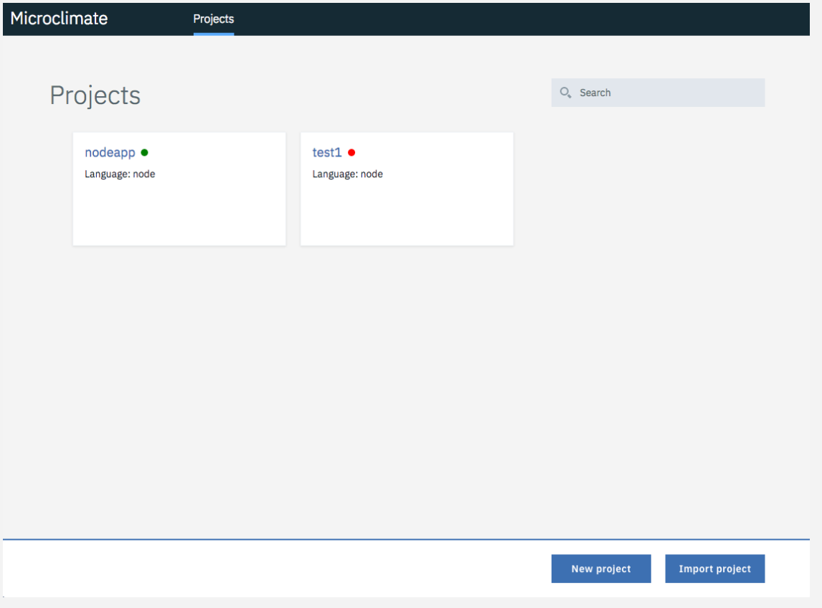
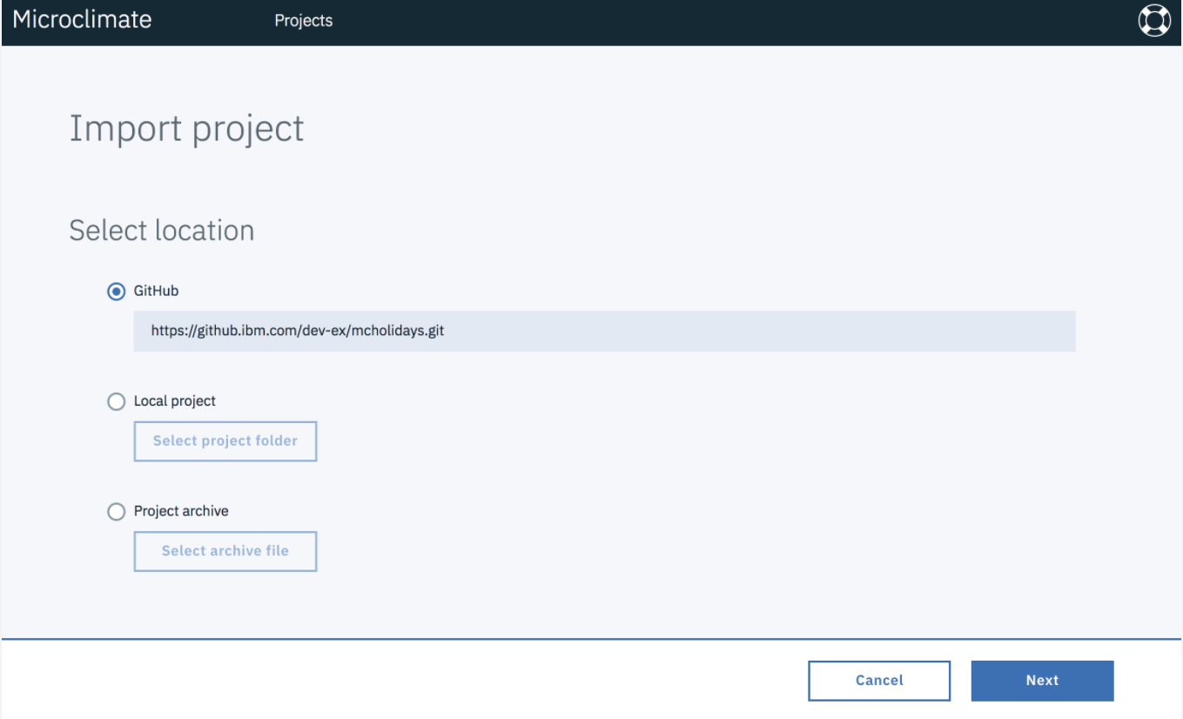
Different ways to begin
Create new cloud native applications using:
Java (MicroProfile, Spring Cloud)
Node
Swift
OR
Import an existing service from:
Git repository
Local disk
Archive

Slide 14
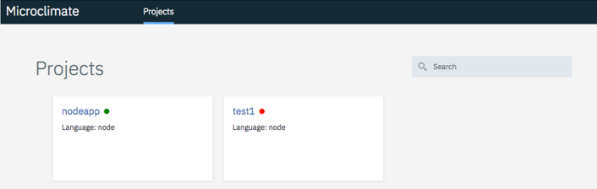
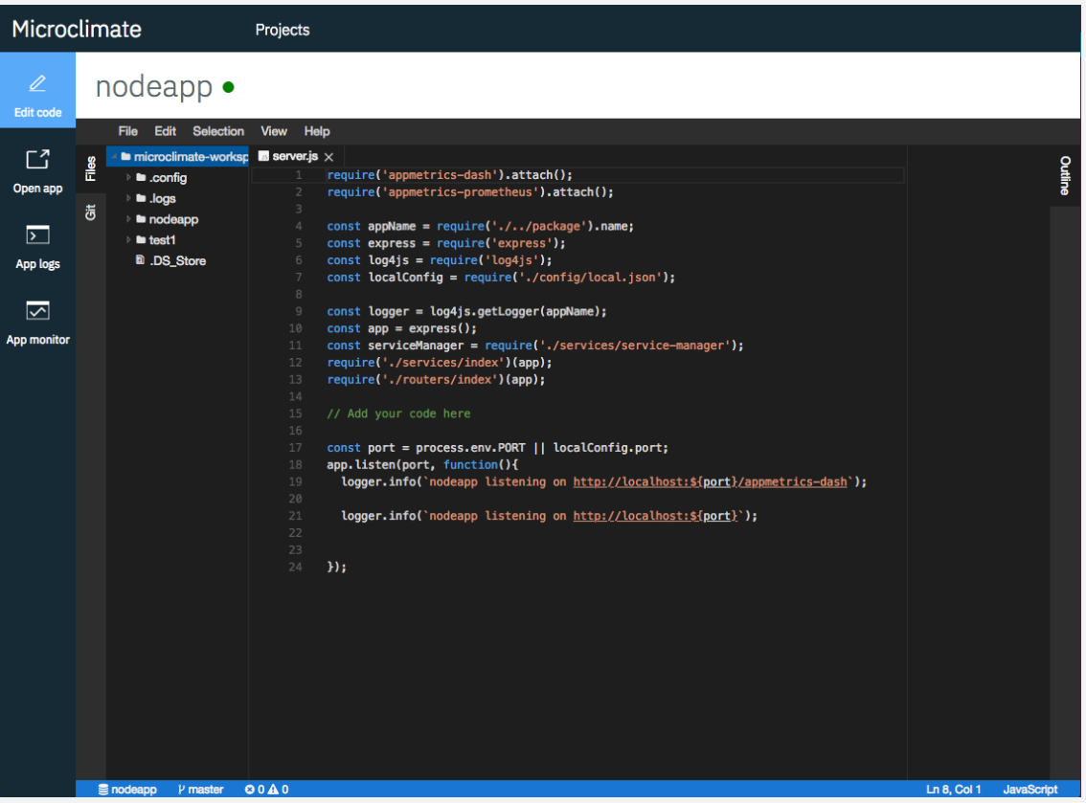
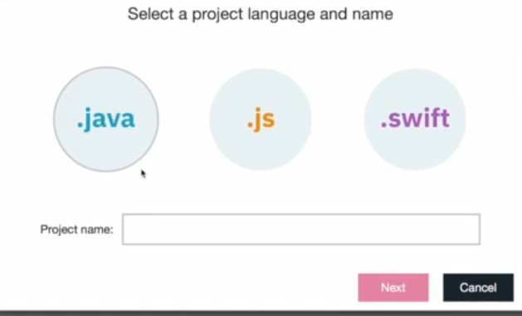
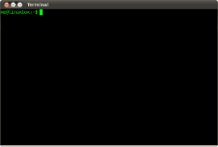
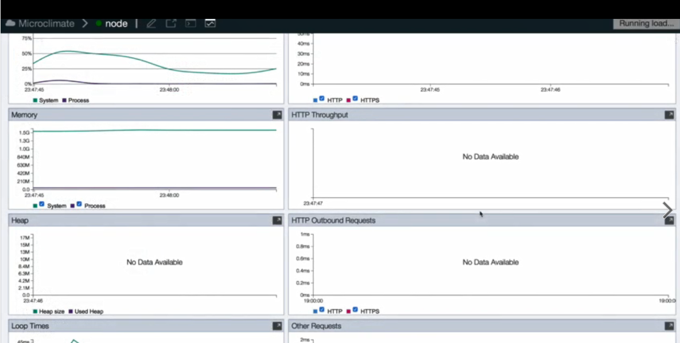







Rapid Onboarding and App Creation
Edit
Compile
Test
Web-based IDE supporting full lifecycle, or BYOE
Rapid Dev Cycle (Inner Loop)
Instant Monitoring & Feedback
Included web IDE, or bring your own
Hosted on ICP, containerized install, or command line tools
Powered by
Language Server Protocol (LSP)
Consistent tools from dev to ops

Slide 15
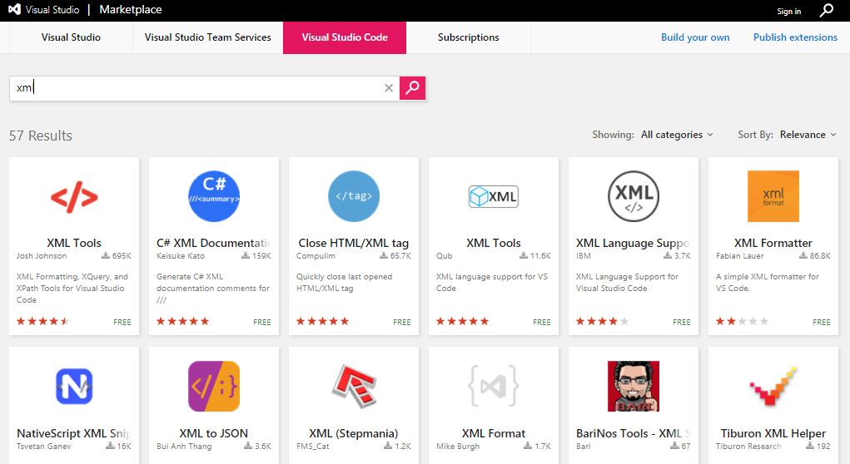
Language Server Protocols
We will provide Language Server Protocol (LSP) for language services and with an uplift to cognitive capabilities on cloud for supporting editors.
1
The Language Server Protocol allows for decoupling language services from the editor so services may be contained within a general purpose language server.
2
Any editor can inherit sophisticated support for many different languages by making use of existing language servers.
Microclimate Development
Notes:
Microclimate is investing in Language server protocols. We open sourced an XML LSP last December which provides value added capability for XML. What is great about LSPs is that you can plug them into any editor that supports LSPs so you don’t have the m x n problem of having to building language support for each editor as they are a little bit different. We’ve started with XML, we encourage customers to use LSPs in their editor and you will continue to see us invest in providing cognitive capabilities through LSPs.

Slide 16











Dev-Ops-Dev-Ops-Dev…
Innovate and improve client experience
By speeding the customer feedback loop by being agile
Flow information back to development
By bringing ops information back to dev, the team is able to work on constant improvement
Development
SCM
Build
Deploy
Testing
Staging
Production
Manage
Feedback
Continuous Integration
Continuous Delivery
Shift Left Information as much as possible

Slide 17
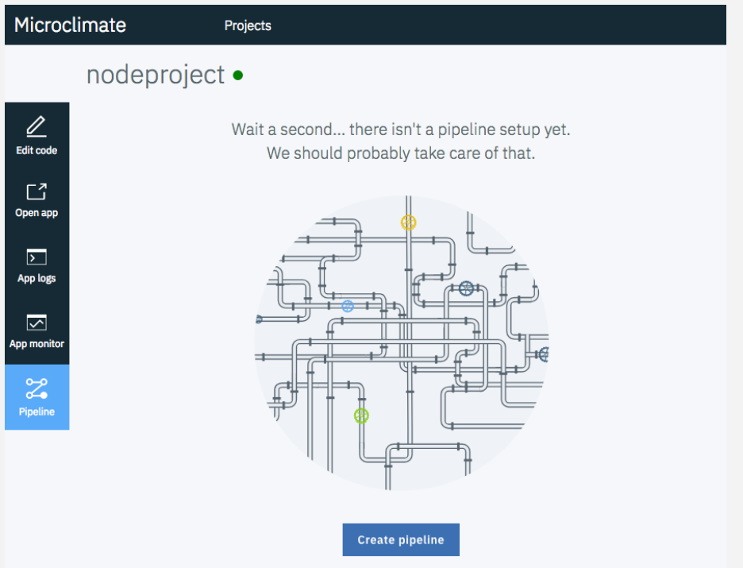
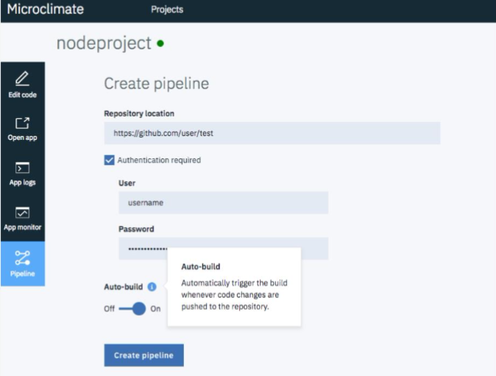
Microclimate DevOps Pipeline
Easily create a new pipeline in Microclimate by providing the repo location and the necessary credentials.

Slide 18
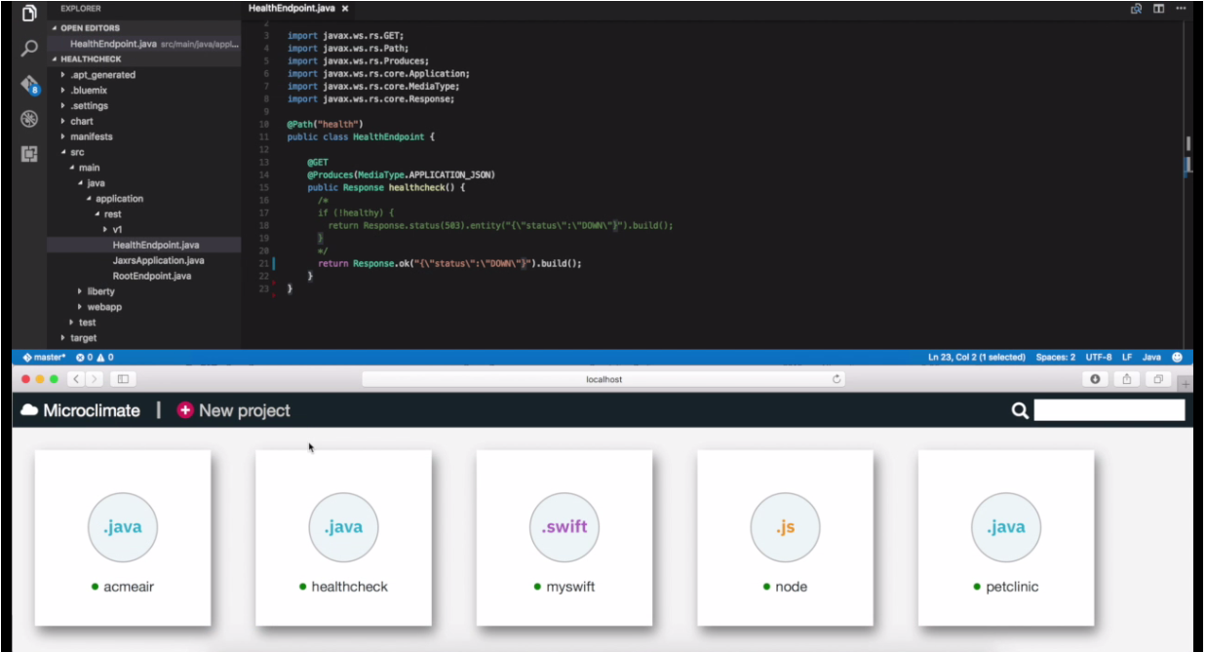
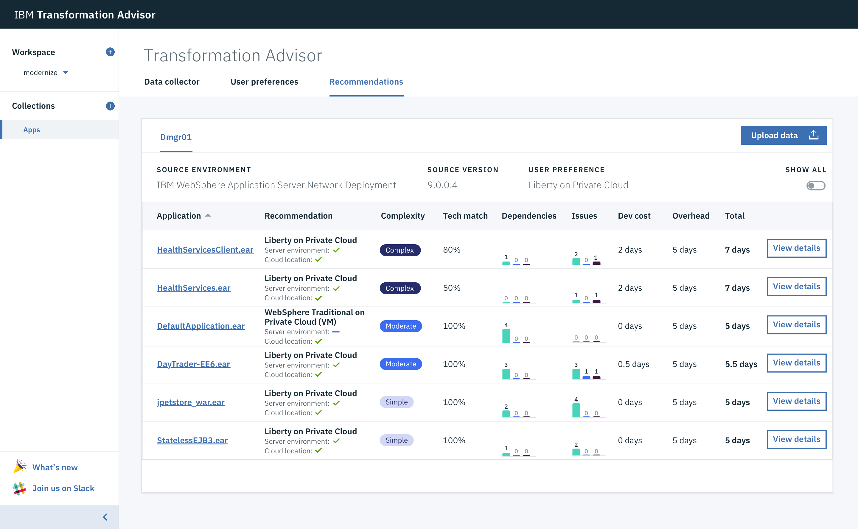
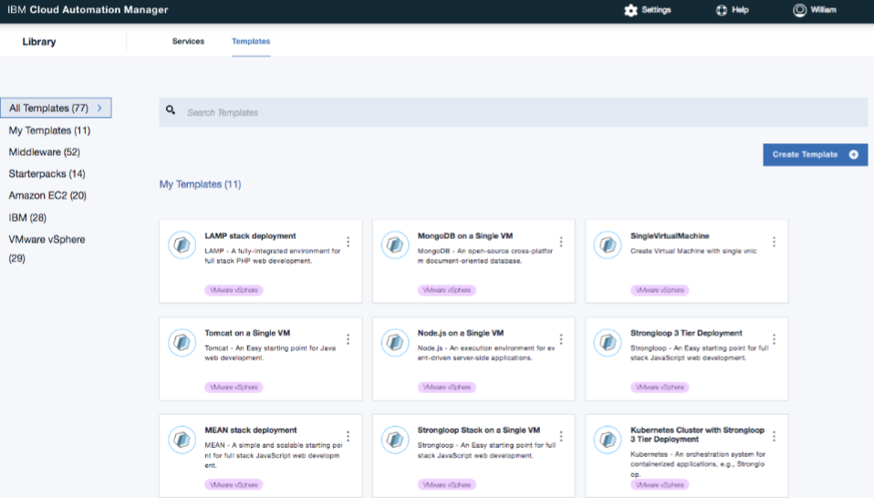
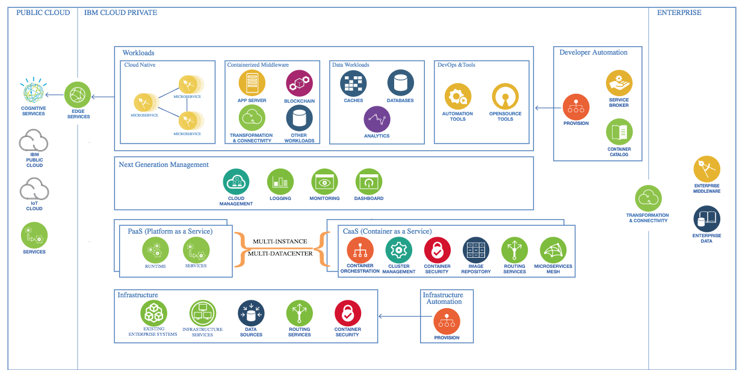
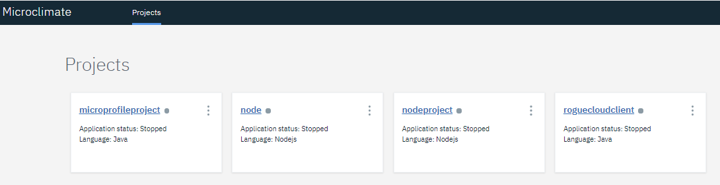
Microclimate – Part of the Solution to Accelerate Modernization
Microclimate
Transformation Advisor
Cloud Automation Manager
IBM Cloud Garage
Best Practices
Reference Architectures
End-to-End Development Experience
Assess and Plan
Prescriptive Guidance
Multi-Cloud Provisioning and management

Slide 19
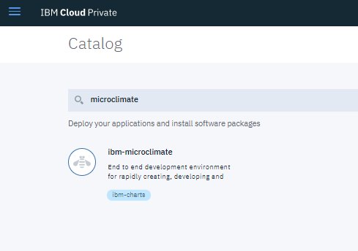
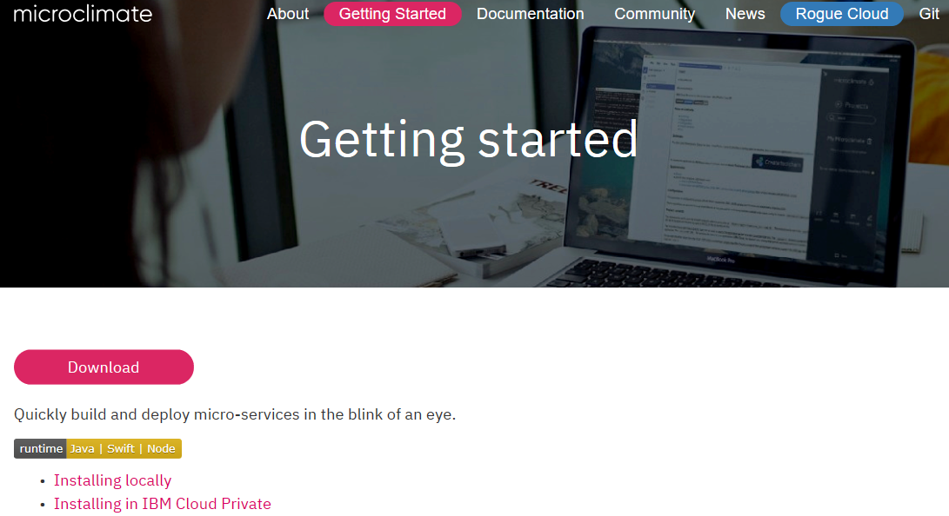
Microclimate – Get started
Freely Available
Download from Microclimate Home Page to run locally (ILAN license)
Install into IBM Cloud private via ICP catalog (supported with ICP license)
Use with IBM Cloud Private Community Edition
Via IBM Cloud Private
Catalog
Via Home Page
https://microclimate-dev2ops.github.io/gettingstarted
19
19
IBM Cloud / © 2018 IBM Corporation

Slide 20
Why Microclimate? It’s a differentiating experience
Polyglot Language Support
Built in Browser Based IDE or Bring your own editor
Fast Inner Loop capability
End to end development via containers
Automated build and deployment
Code Intelligence in Real Time
20
20
IBM Cloud / © 2018 IBM Corporation

Slide 21
References and Resources

Slide 22
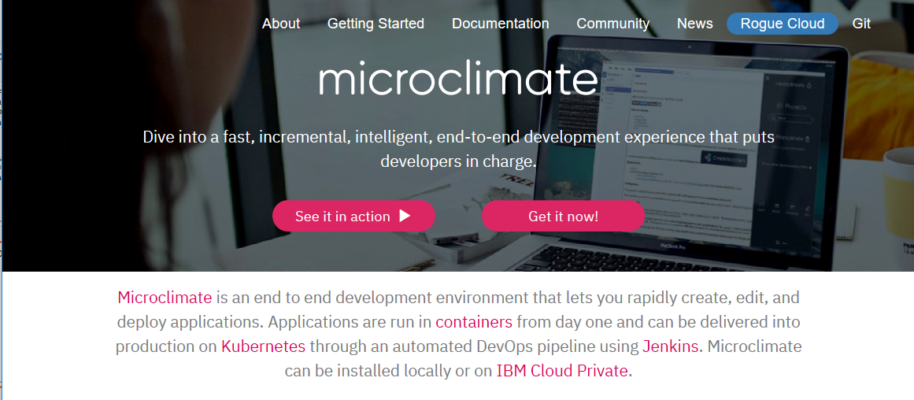
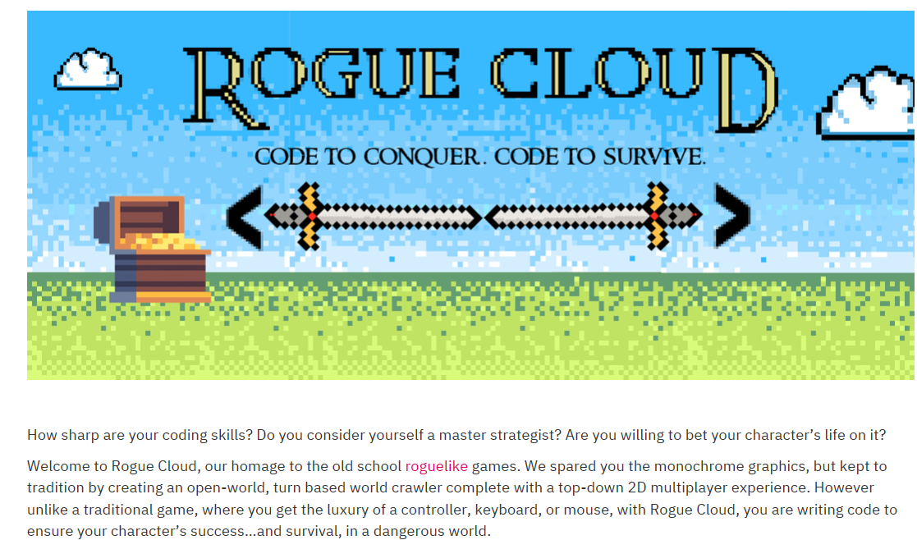

Digital Assets
Home Page
Microclimate overview
Intro videos
Documentation
http://ibm.biz/dev2ops
Rogue Cloud Game
Rogue Cloud overview
Introduces Microclimate through a game experience
Documentation
External Slack Channel
22
22
IBM Cloud / © 2018 IBM Corporation

Slide 23
Notices and disclaimers
© 2018 International Business Machines Corporation. No part of this document may be reproduced or transmitted in any form without written permission from IBM.
U.S. Government Users Restricted Rights — use, duplication or disclosure restricted by GSA ADP Schedule Contract with IBM.
Information in these presentations (including information relating to products that have not yet been announced by IBM) has been reviewed for accuracy as of the date of initial publication and could include unintentional technical or typographical errors. IBM shall have no responsibility to update this information. This document is distributed “as is” without any warranty, either express or implied. In no event, shall IBM be liable for any damage arising from the use of this information, including but not limited to, loss of data, business interruption, loss of profit or loss of opportunity. IBM products and services are warranted per the terms and conditions of the agreements under which they are provided.
IBM products are manufactured from new parts or new and used parts. In some cases, a product may not be new and may have been previously installed. Regardless, our warranty terms apply.”
Any statements regarding IBM's future direction, intent or product plans are subject to change or withdrawal without notice.
Performance data contained herein was generally obtained in a controlled, isolated environments. Customer examples are presented as illustrations of how those
customers have used IBM products and the results they may have achieved. Actual performance, cost, savings or other results in other operating environments may vary.
References in this document to IBM products, programs, or services does not imply that IBM intends to make such products, programs or services available in all countries in which IBM operates or does business.
Workshops, sessions and associated materials may have been prepared by independent session speakers, and do not necessarily reflect the views of IBM. All materials and discussions are provided for informational purposes only, and are neither intended to, nor shall constitute legal or other guidance or advice to any individual participant or their specific situation.
It is the customer’s responsibility to insure its own compliance with legal requirements and to obtain advice of competent legal counsel as to the identification and interpretation of any relevant laws and regulatory requirements that may affect the customer’s business and any actions the customer may need to take to comply with such laws. IBM does not provide legal advice or represent or warrant that its services or products will ensure that the customer follows any law.

Slide 24
Notices and disclaimers continued
Information concerning non-IBM products was obtained from the suppliers of those products, their published announcements or other publicly available sources. IBM has not tested those products about this publication and cannot confirm the accuracy of performance, compatibility or any other claims related to non-IBM products. Questions on the capabilities of non-IBM products should be addressed to the suppliers of those products. IBM does not warrant the quality of any third-party products, or the ability of any such third-party products to interoperate with IBM’s products. IBM expressly disclaims all warranties, expressed or implied, including but not limited to, the implied warranties of merchantability and fitness for a purpose.
The provision of the information contained herein is not intended to, and does not, grant any right or license under any IBM patents, copyrights, trademarks or other intellectual property right.
IBM, the IBM logo, ibm.com and [names of other referenced IBM products and services used in the presentation] are trademarks of International Business Machines Corporation, registered in many jurisdictions worldwide. Other product and service names might be trademarks of IBM or other companies. A current list of IBM trademarks is available on the Web at "Copyright and trademark information" at: www.ibm.com/legal/copytrade.shtml.

